Slide 1


The PiXL Club The PiXL Club The PiXL Club The PiXL Club The PiXL Club The PiXL Club The PiXL Club The PiXL Club The PiXL Club The PiXL Club The PiXL Club The PiXL Club The PiXL Club The PiXL Club The PiXL Club The PiXL Club The PiXL Club The PiXL Club The PiXL Club The PiXL Club The PiXL Club The PiXL Club The PiXL Club The PiXL Club The PiXL Club The PiXL Club The PiXL Club The PiXL Club The PiXL Club The PiXL Club The PiXL Club The PiXL Club The PiXL Club The PiXL Club The PiXL Club The PiXL Club The PiXL Club The PiXL Club The PiXL Club The PiXL Club The PiXL Club The PiXL Club The PiXL Club The PiXL Club The PiXL Club XL Club The PiXL Club The PiXL Club The PiXL Club The PiXL Club The PiXL Club The PiXL Club The PiXL Club The PiXL Club The PiXL Club The PiXL Club The PiXL Club The PiXL Club The PiXL Club The PiXL Club The PiXL Club The PiXL Club The PiXL Club The PiXL Club The PiXL Club The PiXL Club The PiXL Club The PiXL Club The PiXL Club The PiXL Club The PiXL Club The PiXL Club The PiXL Club The PiXL Club The PiXL Club The PiXL Club The PiXL Club The PiXL Club The PiXL Club The PiXL Club The PiXL Club The PiXL Club The PiXL Club The PiXL Club The PiXL Club The PiXL Club The PiXL Club The PiXL Club The PiXL Club The PiXL Club The PiXL Club The PiXL Club The PiXL Club The PiXL Club The PiXL Club The PiXL Club The PiXL Club The PiXL Club The PiXL Club The PiXL Club The PiXL Club The PiXL Club The PiXL Club The PiXL Club The PiXL Club The PiXL Club The PiXL Club The PiXL Club The PiXL Club The PiXL Club The PiXL Club The PiXL Club The PiXL Club The PiXL Club The PiXL Club The PiXL Club The PiXL Club The PiXL Club The PiXL Club The PiXL Club The PiXL Club The PiXL Club The PiXL Club The PiXL Club The PiXL Club The PiXL Club The PiXL Club The PiXL Club The PiXL Club The PiXL Club The PiXL Club The PiXL Club The PiXL Club The PiXL Club The PiXL Club The PiXL Club The PiXL Club The PiXL Club The PiXL Club The PiXL Club The PiXL Club The PiXL Club The PiXL Club The PiXL Club The PiXL Club The PiXL Club The PiXL Club The PiXL Club The PiXL Club The PiXL Club The PiXL Club The PiXL Club The PiXL Club The PiXL Club The PiXL Club The PiXL Club The PiXL Club The PiXL Club The PiXL Club The PiXL Club The PiXL Club The PiXL Club The PiXL Club The PiXL Club The PiXL Club The PiXL Club The PiXL Club The PiXL Club The PiXL Club The PiXL Club The PiXL Club The PiXL Club The PiXL Club The PiXL Club The PiXL Club The PiXL Club The PiXL Club The PiXL Club The PiXL Club The PiXL Club The PiXL Club The PiXL Club The PiXL Club The PiXL Club The PiXL Club The PiXL Club The PiXL Club The PiXL Club The PiXL Club The PiXL Club The PiXL Club The PiXL Club The PiXL Club The PiXL Club The PiXL Club The PiXL Club The PiXL Club The PiXL Club The PiXL Club The PiXL Club The PiXL Club The PiXL Club The PiXL Club The PiXL Club The PiXL Club The PiXL Club The PiXL Club The PiXL Club The PiXL Club The PiXL Club The PiXL Club The PiXL Club The PiXL Club The PiXL Club The PiXL Club The PiXL Club The PiXL Club The PiXL Club The PiXL Club The PiXL Club The PiXL Club The PiXL Club The PiXL Club The PiXL Club The PiXL Club The PiXL Club The PiXL Club The PiXL Club The PiXL Club The PiXL Club The PiXL Club The PiXL Club The PiXL Club The PiXL Club The PiXL Club The PiXL Club The PiXL Club The PiXL Club The PiXL Club The PiXL Club The PiXL Club The PiXL Club The PiXL Club The PiXL Club The PiXL Club The PiXL Club The PiXL Club The PiXL Club The PiXL Club The PiXL Club The PiXL Club The PiXL Club The PiXL Club The PiXL Club The PiXL Club The PiXL Club The PiXL Club The PiXL Club The PiXL Club The PiXL Club The PiXL Club The PiXL Club The PiXL Club The PiXL Club The PiXL Club The PiXL Club The PiXL Club The PiXL Club The PiXL Club The PiXL Club The PiXL Club The PiXL Club The PiXL Club The PiXL Club The PiXL Club The PiXL Club The PiXL Club The PiXL Club The PiXL Club The PiXL Club The PiXL Club The PiXL Club The PiXL Club The PiXL Club The PiXL Club The PiXL Club The PiXL Club The PiXL Club The PiXL Club The PiXL Club The PiXL Club The PiXL Club The PiXL Club The PiXL Club The PiXL Club The PiXL Club The PiXL Club The PiXL Club The PiXL Club The PiXL Club The PiXL Club The PiXL Club The PiXL Club The PiXL Club The PiXL Club The PiXL Club The PiXL Club The PiXL Club The PiXL Club The PiXL Club The PiXL Club The PiXL Club The PiXL Club The PiXL Club The PiXL Club The PiXL Club The PiXL Club The PiXL Club The PiXL Club The PiXL Club The PiXL Club The PiXL Club The PiXL Club The PiXL Club The PiXL Club The PiXL Club The PiXL Club The PiXL Club The PiXL Club The PiXL Club The PiXL Club The PiXL Club The PiXL Club The PiXL Club The PiXL Club The PiXL Club The PiXL Club The PiXL Club The PiXL Club The PiXL Club The PiXL Club The PiXL Club The PiXL Club The PiXL Club The PiXL Club The PiXL Club The PiXL Club The PiXL Club The PiXL Club The PiXL Club The PiXL Club The PiXL Club The PiXL Club The PiXL Club The PiXL Club The PiXL Club The PiXL Club The PiXL Club The PiXL Club The PiXL Club The PiXL Club The PiXL Club The PiXL Club The PiXL Club The PiXL Club The PiXL Club The PiXL Club The PiXL Club The PiXL Club The PiXL Club The PiXL Club The PiXL Club The PiXL Club The PiXL Club The PiXL Club The PiXL Club The PiXL Club The PiXL Club The PiXL Club The PiXL Club The PiXL Club The PiXL Club The PiXL Club The PiXL Club The PiXL Club The PiXL Club The PiXL Club The PiXL Club The PiXL Club The PiXL Club The PiXL Club The PiXL Club The PiXL Club The PiXL Club The PiXL Club The PiXL Club The PiXL Club The PiXL Club The PiXL Club The PiXL Club The PiXL Club The PiXL Club The PiXL Club The PiXL Club The PiXL Club The PiXL Club The PiXL Club The PiXL Club The PiXL Club The PiXL Club The PiXL Club The PiXL Club The PiXL Club The PiXL Club The PiXL Club The PiXL Club The PiXL Club The PiXL Club The PiXL Club The PiXL Club The PiXL Club The PiXL Club The PiXL Club The PiXL Club The PiXL Club The PiXL Club The PiXL Club The PiXL Club The PiXL Club The PiXL Club The PiXL Club The PiXL Club The PiXL Club The PiXL Club The PiXL Club The PiXL Club The PiXL Club The PiXL Club The PiXL Club The PiXL Club The PiXL Club The PiXL Club The PiXL Club The PiXL Club The PiXL Club The PiXL Club The PiXL Club The PiXL Club The PiXL Club The PiXL Club The PiXL Club The PiXL Club The PiXL Club The PiXL Club The PiXL Club The PiXL Club The PiXL Club The PiXL Club The PiXL Club The PiXL Club The PiXL Club The PiXL Club The PiXL Club The PiXL Club The PiXL Club The PiXL Club The PiXL Club The PiXL Club The PiXL Club The PiXL Club The PiXL Club The PiXL Club The PiXL Club The PiXL Club The PiXL Club The PiXL Club The PiXL Club The PiXL Club The PiXL Club The PiXL Club The PiXL Club The PiXL Club The PiXL Club The PiXL Club The PiXL Club The PiXL Club The PiXL Club The PiXL Club The PiXL Club The PiXL Club The PiXL Club The PiXL Club The PiXL Club The PiXL Club The PiXL Club The PiXL Club The PiXL Club The PiXL Club The PiXL Club The PiXL Club The PiXL Club The PiXL Club The PiXL Club The PiXL Club The PiXL Club The PiXL Club The PiXL Club The PiXL Club The PiXL Club The PiXL Club The PiXL Club The PiXL Club The PiXL Club The PiXL Club The PiXL Club The PiXL Club The PiXL Club The PiXL Club The PiXL Club The PiXL Club The PiXL Club The PiXL Club The PiXL Club The PiXL Club The PiXL Club The PiXL Club The PiXL Club The PiXL Club The PiXL Club The PiXL Club The PiXL Club The PiXL Club The PiXL Club The PiXL Club The PiXL Club The PiXL Club The PiXL Club The PiXL Club The PiXL Club The PiXL Club The PiXL Club The PiXL Club The PiXL Club The PiXL Club The PiXL Club The PiXL Club The PiXL Club The PiXL Club The PiXL Club The PiXL Club The PiXL Club The PiXL Club The PiXL Club The PiXL Club The PiXL Club The PiXL Club The PiXL Club The PiXL Club The PiXL Club The PiXL Club The PiXL Club The PiXL Club The PiXL Club The PiXL Club The PiXL Club The PiXL Club The PiXL Club The PiXL Club The PiXL Club The PiXL Club The PiXL Club The PiXL Club The PiXL Club The PiXL Club The PiXL Club The PiXL Club The PiXL Club The PiXL Club The PiXL Club The PiXL Club The PiXL Club The PiXL Club The PiXL Club The PiXL Club The PiXL Club The PiXL Club The PiXL Club The PiXL Club The PiXL Club The PiXL Club The PiXL Club The PiXL Club The PiXL Club The PiXL Club The PiXL Club The PiXL Club The PiXL Club The PiXL Club The PiXL Club The PiXL Club The PiXL Club The PiXL Club The PiXL Club The PiXL Club The PiXL Club The PiXL Club The PiXL Club The PiXL Club The PiXL Club The PiXL Club The PiXL Club The PiXL Club The PiXL Club The PiXL Club The PiXL Club The PiXL Club The PiXL Club The PiXL Club The PiXL Club The PiXL Club The PiXL Club The PiXL Club The PiXL Club The PiXL Club The PiXL Club The PiXL Club The PiXL Club The PiXL Club The PiXL Club The PiXL Club The PiXL Club The PiXL Club The PiXL Club The PiXL Club The PiXL Club The PiXL Club The PiXL Club The PiXL Club The PiXL Club The PiXL Club The PiXL Club The PiXL Club The PiXL Club The PiXL Club The PiXL Club The PiXL Club The PiXL Club The PiXL Club The PiXL Club The PiXL Club The PiXL Club The PiXL Club The PiXL Club The PiXL Club The PiXL Club The PiXL Club The PiXL Club The PiXL Club The PiXL Club The PiXL Club The PiXL Club The PiXL Club The PiXL Club The PiXL Club The PiXL Club The PiXL Club The PiXL Club The PiXL Club The PiXL Club The PiXL Club The PiXL Club The PiXL Club The PiXL Club The PiXL Club The PiXL Club The PiXL Club The PiXL Club The PiXL Club The PiXL Club The PiXL Club The PiXL Club The PiXL Club The PiXL Club The PiXL Club The PiXL Club The PiXL Club The PiXL Club The PiXL Club The PiXL Club The PiXL Club The PiXL Club The PiXL Club The PiXL Club The PiXL Club The PiXL Club The PiXL Club The PiXL Club The PiXL Club The PiXL Club The PiXL Club The PiXL Club The PiXL Club The PiXL Club The PiXL Club The PiXL Club The PiXL Club The PiXL Club The PiXL Club The PiXL Club The PiXL Club The PiXL Club The PiXL Club The PiXL Club The PiXL Club The PiXL Club The PiXL Club The PiXL Club The PiXL Club The PiXL Club The PiXL Club The PiXL Club The PiXL Club The PiXL Club The PiXL Club The PiXL Club The PiXL Club The PiXL Club The PiXL Club The PiXL Club The PiXL Club The PiXL Club The PiXL Club The PiXL Club The PiXL Club The PiXL Club The PiXL Club The PiXL Club The PiXL Club The PiXL Club The PiXL Club The PiXL Club The PiXL Club The PiXL Club The PiXL Club The PiXL Club The PiXL Club
PiXL KnowIT!
GCSE Chemistry
AQA Topic – The Rate And Extent of Chemical Change
© Copyright The PiXL Club Ltd, 2017
This resource is strictly for the use of member schools for as long as they remain members of The PiXL Club. It may not be copied, sold nor transferred to a third party or used by the school after membership ceases. Until such time it may be freely used within the member school.
All opinions and contributions are those of the authors. The contents of this resource are not connected with nor endorsed by any other company, organisation or institution.
www.pixl.org.uk The PiXL Club Ltd, Company number 07321607

Slide 2
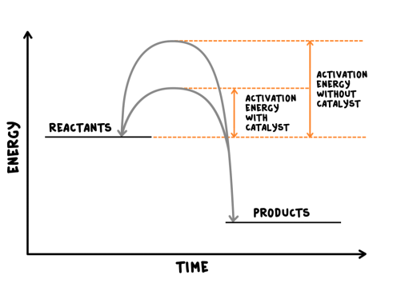
Overview
The Rate And Extent of Chemical Change
Rate of reaction
  Calculating rates of reaction
  Factors which affect the rates of chemical reactions
  Collision theory and activation energy
  Catalysts
Reversible reactions and dynamic equilibrium
  Reversible reaction
  Energy changes and reversible reactions
  Equilibrium
  The effect of changing conditions on equilibrium (HT only)
  The effect of changing concentration (HT only)
  The effect of temperature changes on equilibrium (HT only)
  The effect of pressure changes on equilibrium (HT only)

Slide 3
LearnIT!
KnowIT!
Rate of reaction
Part 1
Calculating rates
of reactions

Slide 4
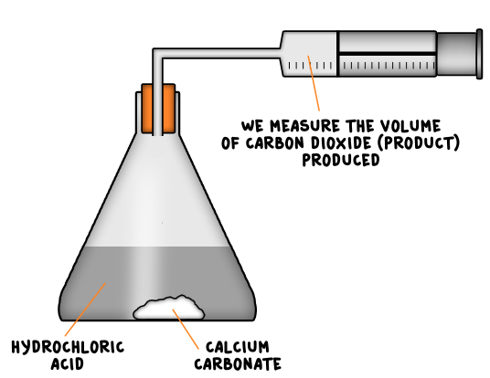
  Rate of reactions part 1 – Calculating rates of reactions
The rate of a chemical reaction can be found by measuring the quantity of a reactant used or the quantity of product formed over time.
Mean rate of reaction = quantity of reactant used
time taken
Mean rate of reaction = quantity of product formed
time taken
The quantity of reactant or product can be measured by the mass in grams or by a volume in cm³.
The units of rate of reaction may be given as g/s or cm³/s.

Slide 5
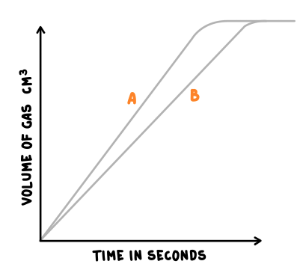
  Rate of reactions part 1 – Calculating rates of reactions
Worked example 1
25cm³ of carbon dioxide was given off in the first 2 seconds of a reaction. Calculate the mean rate of reaction and give the units.
Mean rate of reaction = quantity of product formed
time taken
Mean rate of reaction = 25cm³
2 s
Mean rate of reaction = 12.5 cm³/s
Worked example 2 (Higher Tier)
The above reaction was carried out again. The new results showed that 2 dm³ of carbon dioxide was released in 200 seconds. Calculate the mean rate of reaction in mol/dm³
(1 mole of any gas occupies 24 dm³ at STP)
Moles of carbon dioxide = 2 dm³ = 0.83 moles
24 dm³
Mean rate of reaction = 0.83 moles = 0.0042 mol/s
200 s
Slope A will have a greater rate of reaction as it is steeper.

Slide 6
QuestionIT!
Rate of reaction
Part 1
Calculating rates
of reactions

Slide 7
  Calculating rates of reactions – QuestionIT
State two ways of finding the rate of reaction.
State two units of rate of reaction. (HT: state 3)
State two ways of measuring the quantity of reactant or product.

Slide 8
  Calculating rates of reactions – QuestionIT
A student carries out an experiment reacting hydrochloric acid (HCl) with calcium carbonate (CaCO₃) to give calcium chloride (CaCl₂) carbon dioxide and water. Write the balanced symbol equation for this reaction.
The student collects 50 cm³ of carbon dioxide gas in 10 seconds. What is the rate of reaction? Include the units.

Slide 9
  Calculating rates of reactions – QuestionIT
(HT only) The student repeats the experiment again, this time they find the mass of the carbon dioxide collected. They collect 11 g of carbon dioxide in 10 seconds. Calculate the rate of reaction in mol/s.
(HT only) What mass of carbon dioxide are they collecting per second if the rate of reaction is 0.075 mol/s?

Slide 10

AnswerIT!
Rate of reaction
Part 1
Calculating rates
of reactions

Slide 11
  Calculating rates of reactions – QuestionIT
State two ways of finding the rate of reaction.
Measuring the quantity of reactant used or product formed.
State two units of rate of reaction. (HT: state 3)
g/s; cm³/s; (mol/s)
State two ways of measuring the quantity of reactant or product.
Mass in grams or volume cm³

Slide 12
  Calculating rates of reactions – AnswerIT
A student carries out an experiment reacting hydrochloric acid (HCl) with calcium carbonate (CaCO₃) to give calcium chloride (CaCl₂) carbon dioxide and water. Write the balanced symbol equation for this reaction.
CaCO₃ (s) + 2HCl (aq) → CaCl₂ (aq) + CO₂ (g) + H₂O (l)
The student collects 50 cm³ of carbon dioxide gas in 10 seconds. What is the rate of reaction? Include the units.
rate of reaction = volume of gas collected = 50
time taken 10
5 cm³/s

Slide 13
  Factors which affect the rates of reactions – AnswerIT
(HT only) The student repeats the experiment again, this time they find the mass of the carbon dioxide collected. They collect 11 g of carbon dioxide in 10 seconds. Calculate the rate of reaction in mol/s.
11g/44g = 0.25 moles of carbon dioxide
so 0.25 moles/10 seconds
= 0.025 mol/s
(HT only) What mass of carbon dioxide are they collecting per second if the rate of reaction is 0.075 mol/s
0.075 moles of CO₂ is 44 x 0.075 so 3.3 g/s

Slide 14
LearnIT!
KnowIT!
Rate of reaction
Part 2
Factors which affect the
rate of reactions
Collision theory and activation
energy

Slide 15
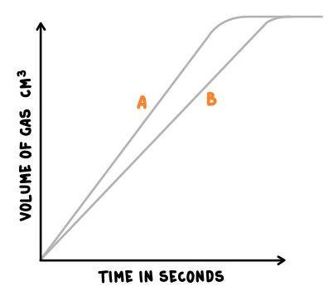
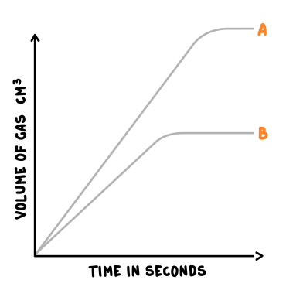
  Rates of reactions part 2 – Factors which affect rates of reactions
Factors which affect the rates of chemical reactions include:
The concentrations of reactants in solution
The pressure of reacting gases
The surface area of solid reactants
The temperature
The presence of a catalyst
Increasing the surface area, temperature or using a catalyst will increase the rate of reaction so the gradient of the line increases from B to A. The difference is that increasing the concentration provides more reacting particles therefore more product, therefore the graph below is produced.
Collision theory explains how these factors affect rates of reactions. According to this theory, chemical reactions can occur only when reacting particles collide with each other and with sufficient energy. The minimum amount of energy that particles must have to react is called the activation energy.
The explanations on the next slide are very important and you will need to use them accurately in the exams to gain credit.

Slide 16
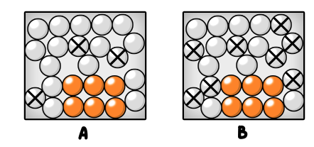
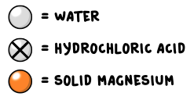
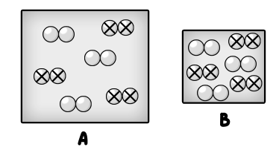

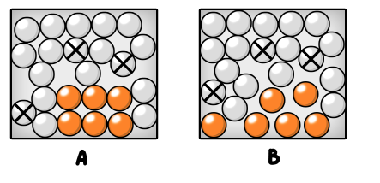
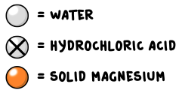
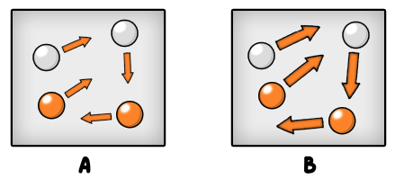

  Rates of reactions part 2 – Factors which affect rates of reactions
Increasing the concentration of reactants in solution increases the frequency of collisions, and so increases the rate of reaction.
Increasing the pressure of reacting gases increases the frequency of collisions, and so increases the rate of reaction.
Increasing the surface area of solid reactants increases the frequency of collisions, and so increases the rate of reaction.
Increasing the temperature increases the frequency of collisions and makes the collisions more energetic, and so increases the rate of reaction.

Slide 17
QuestionIT!
Rate of reaction
Part 2
Factors which affect the
rate of reactions
Collision theory and activation
energy

Slide 18
  Factors which affect rates of reactions – QuestionIT
What is meant by the term ‘collision theory’?
What is meant by the term ‘activation energy’?
What happens to the gradient of a line if the rate of reaction is increased?
What is a catalyst?
According to collision theory, chemical reactions can only occur when…

Slide 19
  Factors which affect rates of reactions – QuestionIT
Other than concentration give three factors that affect the rate of reaction.
Draw a labelled graph to show how changing any one of these factors may affect the rate of reaction. Include the line before and after the change.

Slide 20
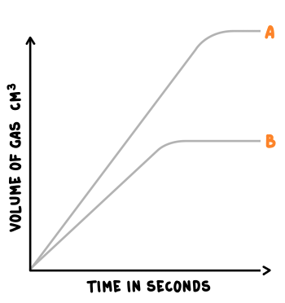
  Factors which affect the rates of reactions – QuestionIT
The graph below shows how the reaction is affected when the concentration of hydrochloric acid is doubled when reacting with excess magnesium. Explain why the amount of hydrogen gas doubles and why the rate of reaction doubles; use collision theory in your response.

Slide 21
AnswerIT!
Rate of reaction
Part 2
Factors which affect the
rate of reactions
Collision theory and activation
energy

Slide 22
  Factors which affect rates of reactions – QuestionIT
What is meant by the term ‘collision theory’?
Explains how factors affect the rate of reaction.
What is meant by the term ‘activation energy’?
Minimum amount of energy that particles must have to react.
What happens to the gradient of a line if the rate of reaction is increased?
Becomes steeper.
What is a catalyst?
Substance which increase the rate of reaction but are not used up during the reaction.
According to collision theory, chemical reactions can only occur when…
reacting particles collide with each other with sufficient energy.

Slide 23
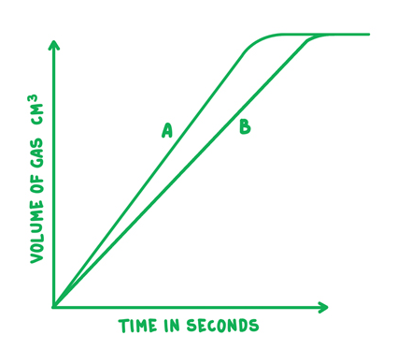
  Factors which affect rates of reactions – AnswerIT
Other than concentration give three factors that affect the rate of reaction.
any from: Temperature, surface area, pressure and a catalyst
Draw a labelled graph to show how changing any one of these factors may affect the rate of reaction. Include the line before and after the change.

Slide 24
  Factors which affect the rates of reactions – AnswerIT
The graph below shows how the reaction is affected when the concentration of hydrochloric acid is doubled when it reacts with excess magnesium. Explain why, using the collision theory the amount of hydrogen gas doubles and why the rate of reaction doubles.
If concentration of acid is doubled then there are twice the number of collisions with magnesium atoms.
There will be twice the number of successful collisions so rate of reaction doubles.
As there are twice as many acid particles (and the magnesium is in excess) there will be twice the volume of (hydrogen) gas released

Slide 25
LearnIT!
KnowIT!
Rate of reaction
Part 3
Catalysts

Slide 26
  Rates of reactions part 3 – Factors which affect rates of reactions - catalysts
Catalysts change the rate of chemical reactions but are not used up during the reaction.
This means that the catalyst is still there, unchanged, at the end of the reaction.
Different reactions need different catalysts. Enzymes act as catalysts in biological systems.
Carbohydrase is an enzyme/catalyst that only breaks down carbohydrate.
Chlorophyll is the catalyst that enables carbon dioxide and water to react together to make glucose during photosynthesis.
Catalysts increase the rate of reaction by providing a different pathway for the reaction that has a lower activation energy.
A reaction profile for a catalysed reaction can be drawn as shown on the right.
You should be able to explain catalytic action in terms of activation energy. For example, “from the reaction profile I can see that the catalyst lowers the activation energy”.

Slide 27
QuestionIT!
Rate of reaction
Part 3
Catalysts

Slide 28
  Factors which affect rates of reactions - catalysts– QuestionIT
1. What is a catalyst?
2. The symbol equation for photosynthesis is:
6CO₂ + 6H₂O → C₆H₁₂O₆ + 6O₂
The catalyst for this reaction is chlorophyll, however it does not
appear in the equation. Why is this?

Slide 29
  Factors which affect rates of reactions - catalysts– QuestionIT
3. A student carried out three reactions to investigate how quickly oxygen gas was given off by decomposing hydrogen peroxide.
2H₂O₂ → O₂ + 2H₂O
Each time she changed the chemical she was adding to see if it was a catalyst. Here are her results.
Which chemical was a catalyst? How do you know?
Chemical | Time taken to collect 50 cm³ in seconds
Without chemical | 33
A | 33
B | No oxygen given off
C | 15

Slide 30
  Factors which affect rates of reactions - catalysts– QuestionIT
Draw the reaction profile for 2H₂O₂ → O₂ + 2H₂O with and without a catalyst and label the activation energies.

Slide 31
AnswerIT!
Rate of reaction
Part 3
Catalysts

Slide 32
  Factors which affect rates of reactions - catalysts– AnswerIT
1. What is a catalyst?.
Catalysts change the rate of chemical reactions, but are not used up during the reaction. They provide a different pathway with a lower activation energy.
2. The symbol equation for photosynthesis is:
6CO₂ + 6H₂O → C₆H₁₂O₆ + 6O₂
The catalyst for this reaction is chlorophyll, however it does not
appear in the equation. Why is this?
It is not a chemical that reacts/it is unchanged at the end of the reaction.

Slide 33
  Factors which affect rates of reactions - catalysts– AnswerIT
3. A student carried out three reactions to investigate how quickly oxygen gas was given off by decomposing hydrogen peroxide.
2H₂O₂ → O₂ + 2H₂O
Each time she changed the chemical she was adding to see if it was a catalyst. Here are her results.
Which chemical was a catalyst? Explain your answer.
C, the time taken for the reaction was shorter.
Chemical | Time taken to collect 50 cm3 in seconds
Without chemical | 33
A | 33
B | No oxygen given off
C | 15

Slide 34
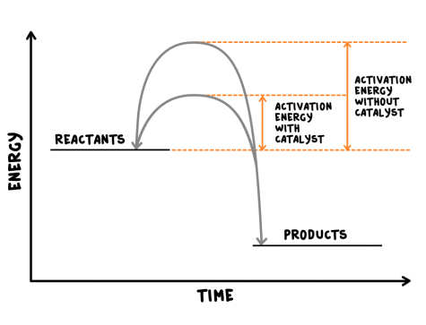
  Factors which affect rates of reactions - catalysts– AnswerIT
Draw the reaction profile for 2H₂O₂ → O₂ + 2H₂O with and without a catalyst and label the activation energies.

Slide 35
LearnIT!
KnowIT!
Reversible reactions and dynamic
Equilibrium (Part 1)
Reversible reactions
Energy changes and reversible reactions
Equilibrium

Slide 36
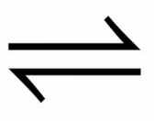
  Reversible reactions
In some chemical reactions, the products of the reaction can react to produce the original reactants. Such reactions are called reversible reactions and are represented by:
A + B C + D
This is different to the usual → or = sign. With these all the reactants change to products in the reaction, but in reversible reactions there are always some reactants and some products.
The direction of reversible reactions can be changed by changing the conditions e.g.
Ammonium chloride ammonia + hydrogen chloride
heat
cool
The reaction above shows that if we heat up the reaction mixture, more ammonium chloride will break down to give ammonia and hydrogen chloride. This is very useful if we are trying to make either of these chemicals.
Conversely if we cool the reaction mixture down we will get more ammonia and hydrogen chloride combining together to make ammonium chloride.

Slide 37
  Reversible reactions
If a reversible reaction is exothermic in one direction, it is endothermic in the opposite direction (they are reversible/opposites). The same amount of energy is transferred in each case e.g.
Hydrated copper sulfate anhydrous copper sulfate + water
endothermic
exothermic
White
Blue
What will happen then in the above reaction if we heat it up?
We will get more anhydrous copper sulfate and water, because the endothermic direction from left to right will absorb the heat we add.
What will happen if we cool it down?
When a reversible reaction occurs in apparatus which prevents the escape of reactants and products, equilibrium is reached as the rate of the forward and reverse reactions occur at exactly the same rate.
If we enclose in this box nitrogen N₂ , hydrogen H₂ and ammonia NH₃ the following reactions take place
N₂ + 3H₂ 2NH₃
When the forward reaction is happening at the same rate as the backwards reaction, there will be no overall change in the amount of any of the three chemicals- equilibrium has been reached.

Slide 38
QuestionIT!
Reversible reactions and dynamic
Equilibrium (Part 1)
Reversible reactions
Energy changes and reversible reactions
Equilibrium

Slide 39
  Reversible reactions QuestionIT
What is meant by a reversible reaction?
Draw the symbol for a reversible reaction.
If a reaction is endothermic in one direction, what is it in the other direction?
What is meant by the term equilibrium?
What needs to happen for equilibrium to be reached?
What can be said about the amount of energy being transferred in a reversible reaction?
The following reversible reaction occurs: The reaction that makes C and D is exothermic. What happens if we heat up A and B?

Slide 40
AnswerIT!
Reversible reactions and dynamic equilibrium (Part 1 )
Reversible reactions
Energy changes and reversible reactions
Equilibrium

Slide 41
  Reversible reactions QuestionIT
What is meant by a reversible reaction?
The products of a reaction can react to produce the original reactants.
Draw the symbol for a reversible reaction.
If a reaction is endothermic in one direction, what is it in the other direction?
Exothermic.
What is meant by the term equilibrium?
Forward and reverse reactions occur at the same rate.
What needs to happen for equilibrium to be reached?
Closed system; apparatus prevents the escape of reactants and products.
What can be said about the amount of energy being transferred in a reversible reaction?
Same amount of energy is transferred in both directions.

Slide 42
  Reversible reactions AnswerIT
The following reversible reaction occurs: The reaction that makes C and D is exothermic. What happens if we heat up A and B?
We will get less C and D

Slide 43
LearnIT!
KnowIT!
Reversible reactions and
dynamic equilibrium (Part 2)
The Effects of changing
Conditions on equilibrium
(HT Only)
Concentration
Temperature
Pressure

Slide 44
  The Effect of changing conditions on equilibrium (HT only)
The relative amounts of all the reactants and products at equilibrium depend on the conditions of the reaction.
Using Le Chatelier’s Principle we can predict what might happen when we change the conditions of a system. A system is simply the reversible reaction that is taking place in an apparatus which prevents any escape of chemicals.
Le Chatelier’s Principle
If a system is at equilibrium and a change is made to any of the conditions, then the system responds to counteract the change
The two equations we are going to use to explain these changes are:
I₂ (g) + H₂ (g) 2HI (g)
and
N₂ (g) + 3H₂ (g) 2NH₃ (g)
How could you change the concentration, temperature or pressure in either of these reactions?
The three conditions which could be changed and are:
Concentration
Temperature
Pressure
You must use Le Chatelier’s principle in your explanation.

Slide 45
  The Effect of changing conditions on equilibrium (HT only)
The Effect of Changing Concentration
If the concentration of one of the reactants or products is changed, the system is no longer at equilibrium and the concentrations of all the substances will change until equilibrium is reached again.
e.g. the hydrogen iodine and hydrogen iodide equilibrium:
I₂ (g) + H₂ (g) 2HI (g)
Increasing the concentration of HI by putting more HI gas into the system makes it react to break down the HI gas to H₂ and I₂ so that we have the same proportions of HI, H₂ and I₂
If the concentration of a reactant is increased, more products will be formed until equilibrium is reached again.
If the concentration of a product is decreased, more reactants will react until equilibrium is reached again.
So if we increase the amount of hydrogen and iodine, more hydrogen iodide gas will be made.
If we decrease the amount of hydrogen iodide, more hydrogen and iodine will react to make hydrogen iodide.

Slide 46
  The Effect of changing conditions on equilibrium (HT only)
The Effect of Changing Temperature
If the temperature of a system at equilibrium is increased:
The relative amount of products at equilibrium increases for an endothermic reaction.
The relative amount of products at equilibrium decreases for an exothermic reaction.
If the temperature of a system at equilibrium is decreased:
The relative amount of products at equilibrium decreases for an endothermic reaction.
The relative amount of products at equilibrium increases for an exothermic reaction.
If we apply these to the equation below:
N₂ (g) + 3H₂ (g) 2NH₃ (g)
exothermic
endothermic
Increasing the temperature will give more nitrogen N₂ and hydrogen H₂ and less ammonia NH_{3.}
Decreasing the temperature the opposite result occurs- we would get more ammonia NH₃ and less nitrogen N₂ and hydrogen H_{2.}

Slide 47
  The Effect of changing conditions on equilibrium (HT only)
The Effect of Changing Pressure
For gaseous reactions at equilibrium:
An increase in pressure causes the equilibrium position to shift towards the side with the smaller number of molecules, as shown by the symbol equation for that reaction.
A decrease in pressure causes the equilibrium position to shift towards the side with
larger number of molecules, as shown by the symbol equation for that reaction.
As 1 mole of gas at STP occupies 24 dm^{3,} we can apply this knowledge to the equation.
N₂ (g) + 3H₂ (g) 2NH₃ (g)
There are 4 moles of reactants: 1 mole of nitrogen N₂ and 3 moles of H₂
There are only 2 moles of the ammonia NH₃ product.
The reactants will have 96 dm³ at STP and the products will only occupy 48 dm³ .
So if we increase the pressure, the equilibrium position will shift towards the right hand side simply because the two moles of ammonia take up a smaller volume so, from Le Chatelier’s principal, making more of the product that has less volume reduces the pressure that we have just increased.

Slide 48
QuestionIT!
Reversible reactions and
dynamic equilibrium (Part 2)
The Effects of changing
Conditions on equilibrium
(HT Only)
Concentration
Temperature
Pressure

Slide 49
  The Effect of changing conditions on equilibrium (HT only)QuestionIT
What is Le Chatelier’s Principle?
What three factors can be changed in a system at equilibrium?
If the concentration of a reactant is increased what will happen to the products of the reaction?
What will happen to the amount of product in an endothermic reaction at equilibrium if the temperature is increased?
What will happen to the amount of product in an exothermic reaction at equilibrium if the temperature is increased?

Slide 50
  The Effect of changing conditions on equilibrium (HT only)QuestionIT
What will happen to the amount of product in an endothermic reaction at equilibrium if the temperature is decreased?
What is meant by the term ‘gaseous reaction’?
What would happen to the position of equilibrium in a gaseous reaction if the pressure is increased?
Using Le Chatelier’s principle, explain what will happen in the following reaction if we increase the concentration of the hydrogen and iodine?
I₂ (g) + H₂ (g) 2HI (g)

Slide 51
  Fuel Cells (Chemistry only)AnswerIT
What will happen if we increase the temperature of the reaction below? Explain why you think this.
N₂ (g) + 3H₂ (g) 2NH₃ (g)
Explain what will happen if we decrease the pressure in the reaction above.

Slide 52
AnswerIT!
Reversible reactions and
dynamic equilibrium (Part 2)
The Effects of changing
Conditions on equilibrium
(HT Only)
Concentration
Temperature
Pressure

Slide 53
  The Effect of changing conditions on equilibrium (HT only)QuestionIT
What is Le Chatelier’s Principle?
If a system is at equilibrium and a change is made to any of the conditions,
then the system responds to counteract the change.
What three factors can be changed in a system at equilibrium?
Concentration, temperature and pressure.
If the concentration of a reactant is increased what will happen to the products of the reaction?
More products will be produced; until equilibrium is reached.
What will happen to the amount of product in an endothermic reaction at equilibrium if the temperature is increased?
More products will be produced.
What will happen to the amount of product in an exothermic reaction at equilibrium if the temperature is increased?
Relative amount of products will decrease.

Slide 54
  The Effect of changing conditions on equilibrium (HT only)QuestionIT
What will happen to the amount of product in an endothermic reaction at equilibrium if the temperature is decreased?
Relative amount of products will decrease.
What is meant by the term ‘gaseous reaction’?
Reaction where all the reactants and products are gases.
What would happen to the position of equilibrium in a gaseous reaction if the pressure is increased?
Equilibrium would shift towards the side with the smaller number of molecules shown in the balanced chemical equation.
Using Le Chatelier’s principle, explain what will happen in the following reaction if we increase the concentration of the hydrogen and iodine?
I₂ (g) + H₂ (g) 2HI (g)
The extra iodine and hydrogen will react together to make more hydrogen
iodide.

Slide 55
  Fuel Cells (Chemistry only)AnswerIT
What will happen if we increase the temperature of the reaction below? Explain why you think this.
N₂ (g) + 3H₂ (g) 2NH₃ (g)
More hydrogen and nitrogen will be made as the backward reaction is
endothermic.
Explain what will happen if we decrease the pressure in the reaction above.
We will get more nitrogen and hydrogen as there are four moles of gas/higher
volume for the reactants.

